Slide 1
6.852: Distributed Algorithms Fall, 2015
Lecture 3

Slide 2
Today’s plan
Algorithms in general synchronous networks, cont’d:
Shortest paths spanning trees
Minimum-weight spanning trees
Maximal independent Sets (MIS)
Reading: Sections 4.3-4.5
[Gallager, Humblet, Spira]
[Luby]
[Metivier, Robson,…]
Next time: (Stephan Holzer):
Maximal Independent Sets, cont’d
Graph coloring
Reading: Peleg, Chapters 7 and 8; related papers

Slide 3
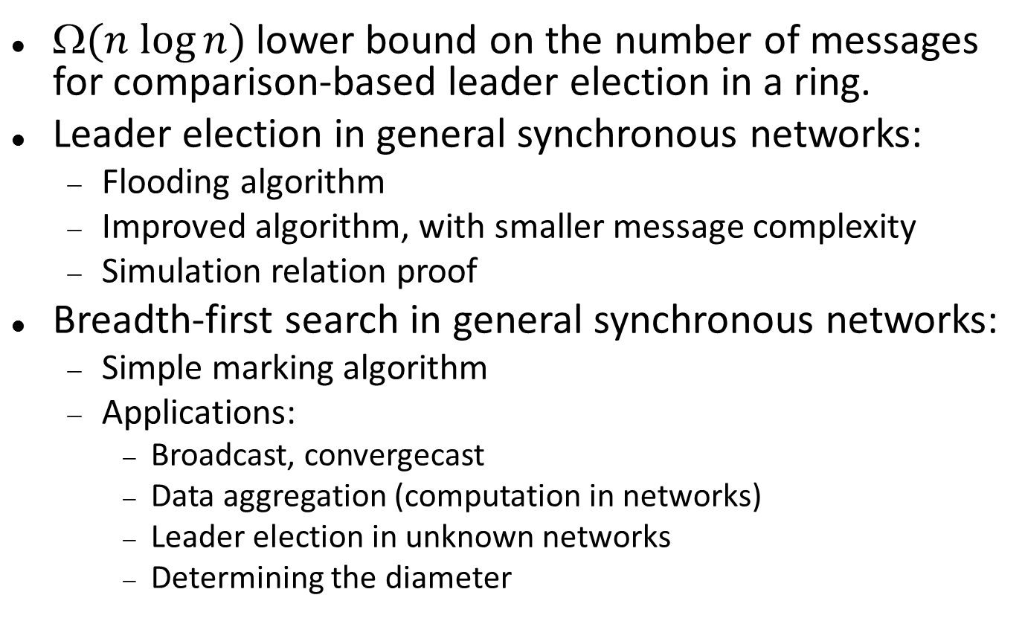
Last time
$(n log⁡n)$lower bound on the number of messages for comparison-based leader election in a ring.
Leader election in general synchronous networks:
Flooding algorithm
Improved algorithm, with smaller message complexity
Simulation relation proof
Breadth-first search in general synchronous networks:
Simple marking algorithm
Applications:
Broadcast, convergecast
Data aggregation (computation in networks)
Leader election in unknown networks
Determining the diameter

Slide 4
Shortest Paths

Slide 5
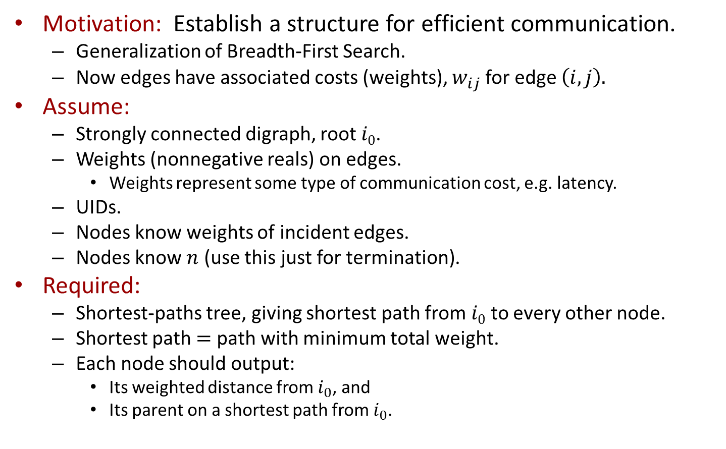
Shortest paths
Motivation: Establish a structure for efficient communication.
Generalization of Breadth-First Search.
Now edges have associated costs (weights), $w_{ij}$for edge $\left(i,j\right).$
Assume:
Strongly connected digraph, root $i0$.
Weights (nonnegative reals) on edges.
Weights represent some type of communication cost, e.g. latency.
UIDs.
Nodes know weights of incident edges.
Nodes know $n$ (use this just for termination).
Required:
Shortest-paths tree, giving shortest path from $i0$ to every other node.
Shortest path $=$ path with minimum total weight.
Each node should output:
Its weighted distance from $i_{0}$, and
Its parent on a shortest path from $i_{0}$.
Notes:
Cost could be a charge to traverse the edge.
Total weight of a path.
Shortest path = path with min total weight.
Mixture of terminology.
Define the weighted distance from one node to another to be the total weight of a shortest path between the nodes.

Slide 6
Shortest paths
7
2
1
10
11
5
1
5
8
6
4
2
3
9
4
3
6

Slide 7
Shortest paths
3
7
2
10
1
10
11
5
1
5
8
6
2
4
0
2
3
9
9
4
3
6
6

Slide 8
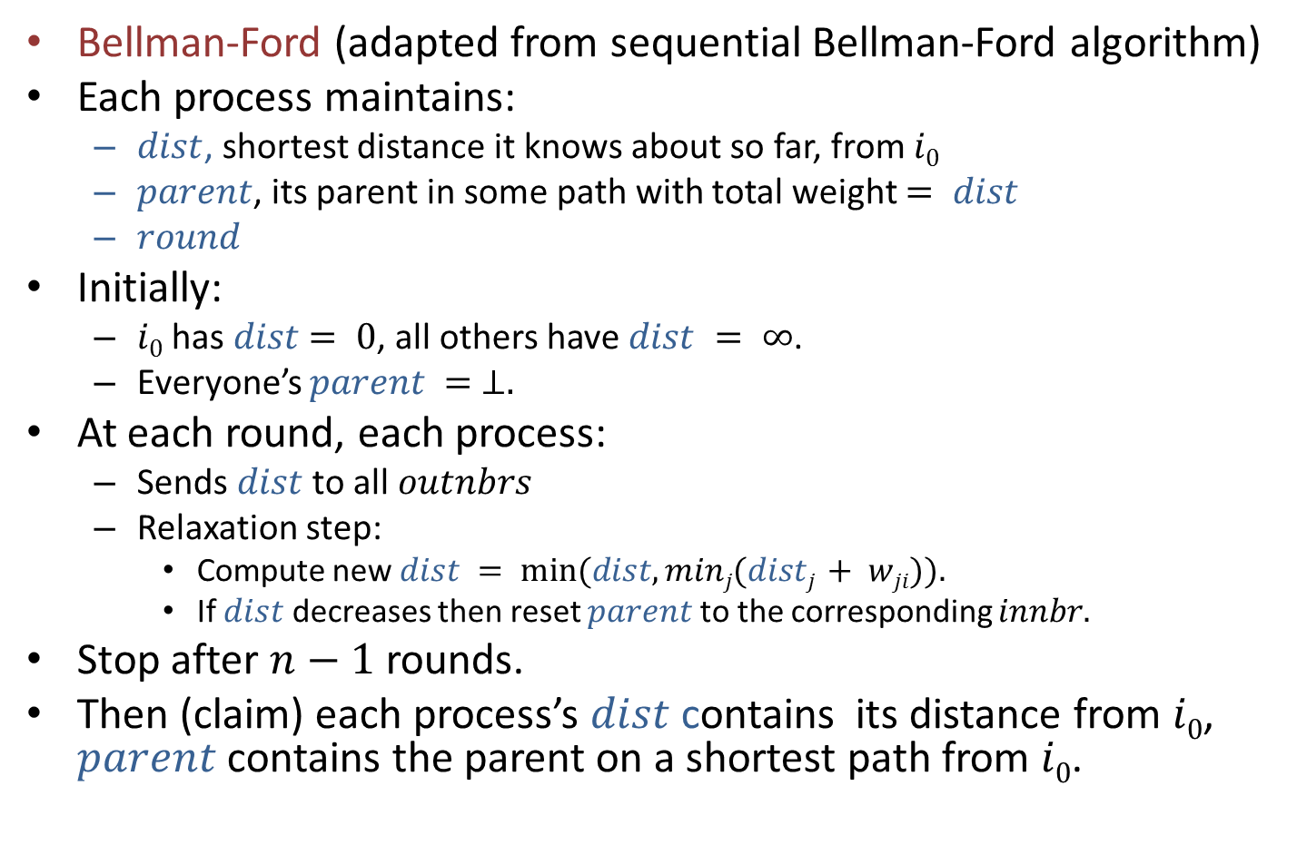
Shortest paths algorithm
Bellman-Ford (adapted from sequential Bellman-Ford algorithm)
Each process maintains:
$dist$, shortest distance it knows about so far, from $i0$
$parent$, its parent in some path with total weight $= dist$
$round$
Initially:
$i0$ has $dist$ $= 0$, all others have $dist = ∞$.
Everyone’s $parent = ⊥.$
At each round, each process:
Sends $dist$ to all $outnbrs$
Relaxation step:
Compute new $dist = min⁡(dist, minj(distj + wji)).$
If $dist$ decreases then reset $parent$to the corresponding $innbr.$
Stop after $n−1$ rounds.
Then (claim) each process’s $dist$ contains its distance from $i0$, $parent$ contains the parent on a shortest path from $i0$.
Notes:
This is called a “relaxation algorithm”.
The min is taken over all in-nbrs.
If dist decreases there is some neighbor whose message caused the decrease. Make that the new parent.
Using knowledge of n for termination. We could do something like the convergecast we used in BFS, but it would be more complicated now because of the changes.

Slide 9





Shortest paths
$$∞$$
7
2
$$∞$$
1
10
11
5
1
5
8
6
$$∞$$
4
0
2
3
$$∞$$
9
4
3
6
$$∞$$
Round 1 (start)

Slide 10









Shortest paths
$$∞$$
7
2
$$∞$$
1
$$∞$$
$$∞$$
10
$$∞$$
11
$$∞$$
5
1
5
$$∞$$
$$∞$$
8
0
6
0
$$∞$$
4
0
2
3
$$∞$$
$$∞$$
9
4
$$∞$$
$$∞$$
3
6
$$∞$$
Round 1 (msgs)

Slide 11
Shortest paths
$$∞$$
7
2
11
1
$$∞$$
$$∞$$
10
$$∞$$
11
$$∞$$
5
1
5
$$∞$$
$$∞$$
8
0
6
0
2
4
0
2
3
$$∞$$
$$∞$$
9
4
$$∞$$
$$∞$$
3
6
$$∞$$
Round 1 (trans)

Slide 12
Shortest paths
$$∞$$
7
2
11
1
10
11
5
1
5
8
6
2
4
0
2
3
$$∞$$
9
4
3
6
$$∞$$
Round 2 (start)
Notes:
Node 1 now has a new distance, 11.
Node 5 has a new distance, 2.
The others are still infinity.

Slide 13
Shortest paths
$$∞$$
7
2
11
1
$$∞$$
$$∞$$
10
2
11
11
$$∞$$
5
1
5
$$∞$$
8
0
6
0
2
4
0
2
3
2
$$∞$$
9
4
$$∞$$
$$∞$$
3
6
$$∞$$
Round 2 (msgs)

Slide 14
Shortest paths
3
7
2
11
1
$$∞$$
$$∞$$
10
2
11
11
$$∞$$
5
1
5
$$∞$$
8
0
6
0
2
4
0
2
3
2
19
9
4
$$∞$$
$$∞$$
3
6
6
Round 2 (trans)
Notes:
Node 3 gets a new distance, 19.
Node 6 gets a new distance, 6.
Node 2 gets a new distance, 3.

Slide 15
Shortest paths
3
7
2
11
1
10
11
5
1
5
8
6
2
4
0
2
3
19
9
4
3
6
6
Round 3 (start)
Notes:
Now there are paths to all nodes.
But they aren’t all shortest paths. E.g., the path to node 3 can be improved.

Slide 16
Shortest paths
3
7
2
11
1
3
3
10
2
11
11
3
5
1
5
19
8
0
6
0
2
4
0
2
3
2
19
9
4
6
6
3
6
6
Round 3 (msgs)

Slide 17
Shortest paths
3
7
2
10
1
3
3
10
2
11
11
3
5
1
5
19
8
0
6
0
2
4
0
2
3
2
9
9
4
6
6
3
6
6
Round 3 (trans)
Notes:
Node 1 gets a better distance, 10 (represents a change from previous 11).
Node 3 also gets a better distance, 9 (replaces 19).

Slide 18
Shortest paths
3
7
2
10
1
10
11
5
1
5
8
6
2
4
0
2
3
9
9
4
3
6
6
Round 4 (start)
Notes:
This is already the best. Additional rounds are carried out just because we are doing a certain number of rounds.

Slide 19
Shortest paths
3
7
2
10
1
3
3
10
2
10
11
3
5
1
5
9
8
0
6
0
2
4
0
2
3
2
9
9
4
6
6
3
6
6
Round 4 (msgs)

Slide 20
Shortest paths
3
7
2
10
1
3
3
10
2
10
11
3
5
1
5
9
8
0
6
0
2
4
0
2
3
2
9
9
4
6
6
3
6
6
Round 4 (trans)
Notes:
No changes now?

Slide 21
Shortest paths
3
7
2
10
1
10
11
5
1
5
8
6
2
4
0
2
3
9
9
4
3
6
6
Round 5 (start)

Slide 22
Shortest paths
3
7
2
10
1
3
3
10
2
10
11
3
5
1
5
9
8
0
6
0
2
4
0
2
3
2
9
9
4
6
6
3
6
6
Round 5 (msgs)

Slide 23
Shortest paths
3
7
2
10
1
3
3
10
2
10
11
3
5
1
5
9
8
0
6
0
2
4
0
2
3
2
9
9
4
6
6
3
6
6
Round 5 (trans)

Slide 24
Shortest paths
3
7
2
10
1
10
11
5
1
5
8
6
2
4
0
2
3
9
9
4
3
6
6
End configuration

Slide 25
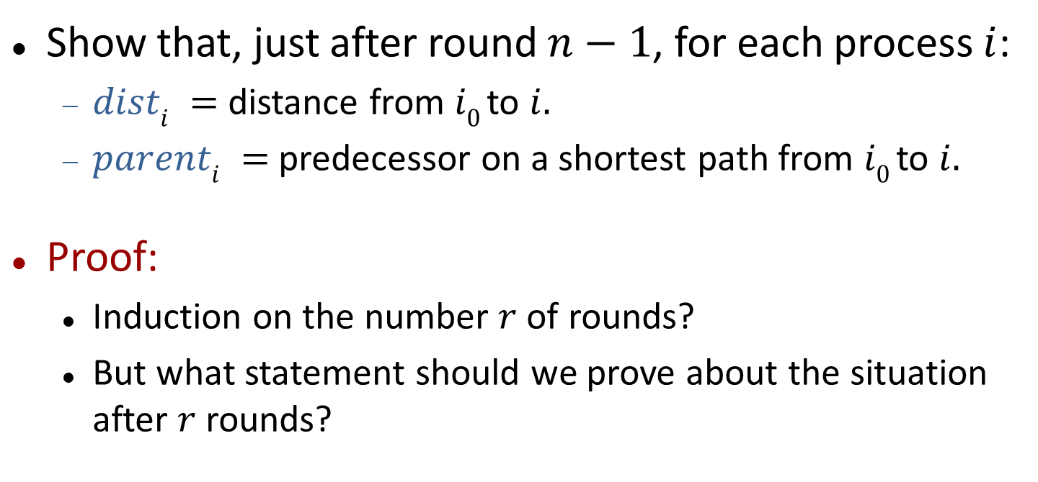
Correctness
Show that, just after round $n−1$, for each process $i$:
$disti =$ distance from $i0$ to $i.$
$parenti =$predecessor on a shortest path from $i0$ to $i.$
Proof:
Induction on the number $r$ of rounds?
But what statement should we prove about the situation after $r$rounds?

Slide 26
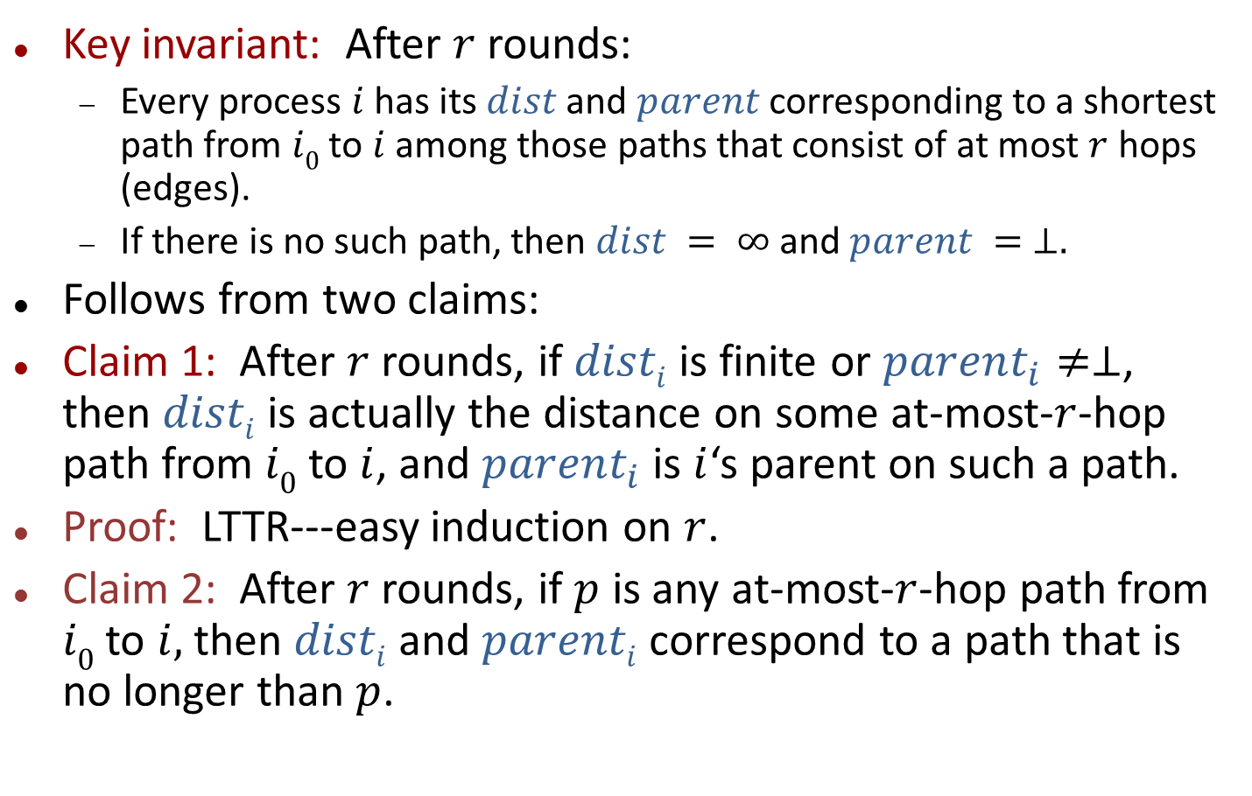
Correctness
Key invariant: After $r$ rounds:
Every process $i$ has its $dist$and $parent$ corresponding to a shortest path from $i0$ to $i$ among those paths that consist of at most $r$ hops (edges).
If there is no such path, then $dist = ∞$and $parent = ⊥.$
Follows from two claims:
Claim 1: After $r$ rounds, if $disti$is finite or $parent_{i}≠⊥$, then $disti$ is actually the distance on some at-most-$r$-hop path from $i0$ to $i$, and $parent_{i}$ is $i$‘s parent on such a path.
Proof: LTTR---easy induction on $r$.
Claim 2: After $r$ rounds, if $p$ is any at-most-$r$-hop path from $i0$ to $i,$ then $disti$and $parenti$ correspond to a path that is no longer than $p$.
Notes:
I’m writing “after r rounds”, but I really mean “just after r rounds”.
Claim 1 is saying that the dist info that is recorded isn’t inappropriately small. It really comes from some path.
Actually, we should state this a bit more strongly: If dist_i is finite or parent is non-bot,
Claim 2 gives the other direction, saying that the distance is small enough---\leq the distance on any path.
Putting these two facts together says that we really have the distance on a shortest path.

Slide 27
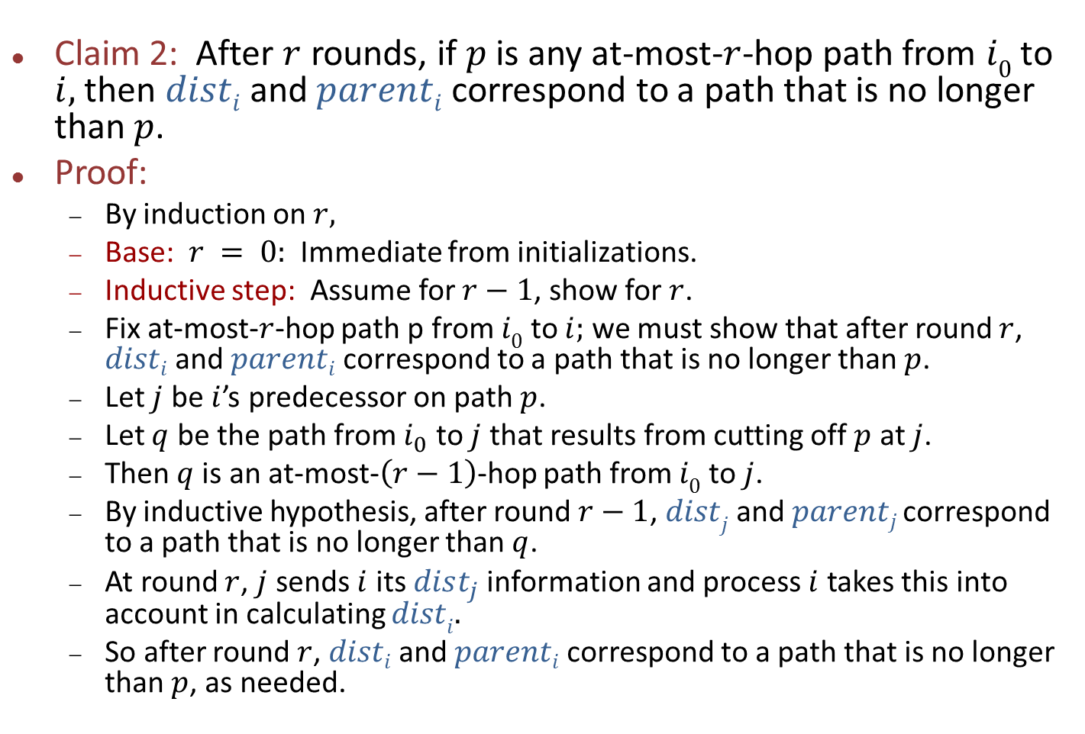
Correctness
Claim 2: After $r$ rounds, if $p$ is any at-most-$r$-hop path from $i0$ to $i,$ then $disti$and $parenti$ correspond to a path that is no longer than $p$.
Proof:
By induction on $r,$
Base: $r = 0:$Immediate from initializations.
Inductive step: Assume for $r−1$, show for $r$.
Fix at-most-$r$-hop path p from $i0$ to $i;$ we must show that after round $r$, $disti$and $parenti$ correspond to a path that is no longer than $p$.
Let $j$ be $i$’s predecessor on path $p$.
Let $q$ be the path from $i_{0}$ to $j$ that results from cutting off $p$ at $j$.
Then $q$is an at-most-$\left(r−1\right)$-hop path from $i0$ to $j$.
By inductive hypothesis, after round $r−1$, $distj$ and $parentj$ correspond to a path that is no longer than $q$.
At round $r$, $j$ sends $i$ its $dist_{j}$information and process $i$ takes this into account in calculating $disti.$
So after round $r$, $disti$and $parenti$ correspond to a path that is no longer than $p$, as needed.

Slide 28
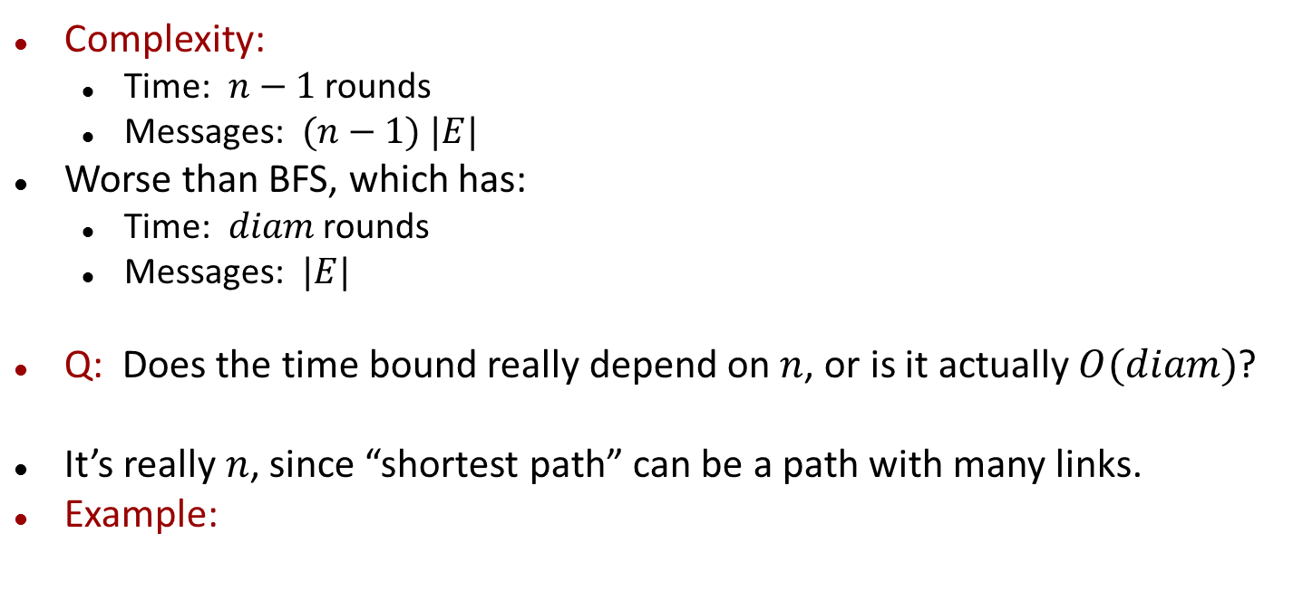
Complexity
Complexity:
Time: $n−1$ rounds
Messages: $(n−1) |E|$
Worse than BFS, which has:
Time: $diam$ rounds
Messages: $|E|$
Q: Does the time bound really depend on $n$, or is it actually $O(diam)$?
It’s really $n$, since “shortest path” can be a path with many links.
Example:
79
i₀
i
1
1
1
1
1
i₀
i₀
i₀
i₀
Notes:
The extra costs arise because of the changes.

Slide 29
Remarks
We will revisit Bellman-Ford for asynchronous networks.
Gets even more expensive there.
Similar to an old Arpanet routing algorithm.
Consider more interesting termination strategy then.
Notes:
Termination: We could use a convergecast strategy as for BFS, but it gets more complicated because of the changes. Nodes might have to participate repeatedly as the tree changes. We’ll see this again when we study asynchronous algorithms.

Slide 30
Minimum Spanning Trees [Gallager, Humblet, Spira]
Notes:
Really, it’s based on GHS, but it’s simpler because it’s synchronous.

Slide 31
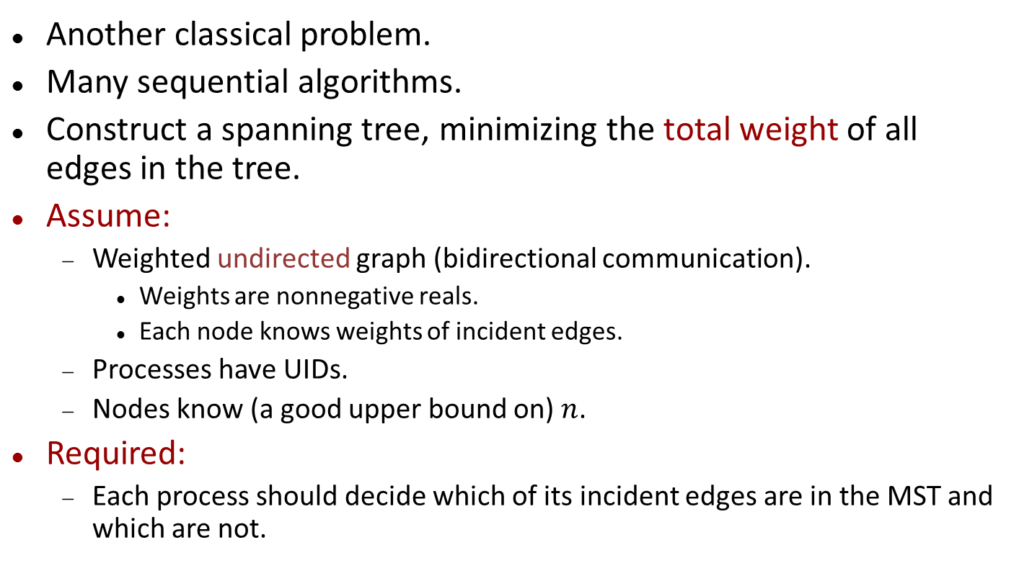
Minimum Spanning Tree (MST)
Another classical problem.
Many sequential algorithms.
Construct a spanning tree, minimizing the total weight of all edges in the tree.
Assume:
Weighted undirected graph (bidirectional communication).
Weights are nonnegative reals.
Each node knows weights of incident edges.
Processes have UIDs.
Nodes know (a good upper bound on) $n$.
Required:
Each process should decide which of its incident edges are in the MST and which are not.
Notes:
The weights might represent monetary costs of using links, in which case we’d want to minimize the total weight in order to minimize the cost.
We use knowledge of n only for synchronization and termination. When we get to the asynchronous version of the algorithm, we won’t use this knowledge anymore (but things do get harder).

Slide 32
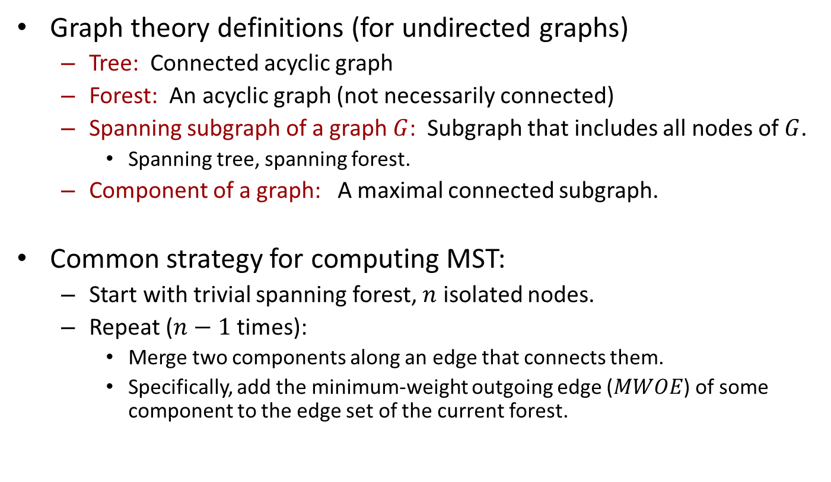
Minimum spanning tree theory
Graph theory definitions (for undirected graphs)
Tree: Connected acyclic graph
Forest: An acyclic graph (not necessarily connected)
Spanning subgraph of a graph $G$: Subgraph that includes all nodes of $G$.
Spanning tree, spanning forest.
Component of a graph: A maximal connected subgraph.
Common strategy for computing MST:
Start with trivial spanning forest, $n$ isolated nodes.
Repeat ($n−1$ times):
Merge two components along an edge that connects them.
Specifically, add the minimum-weight outgoing edge ($MWOE$) of some component to the edge set of the current forest.

Slide 33
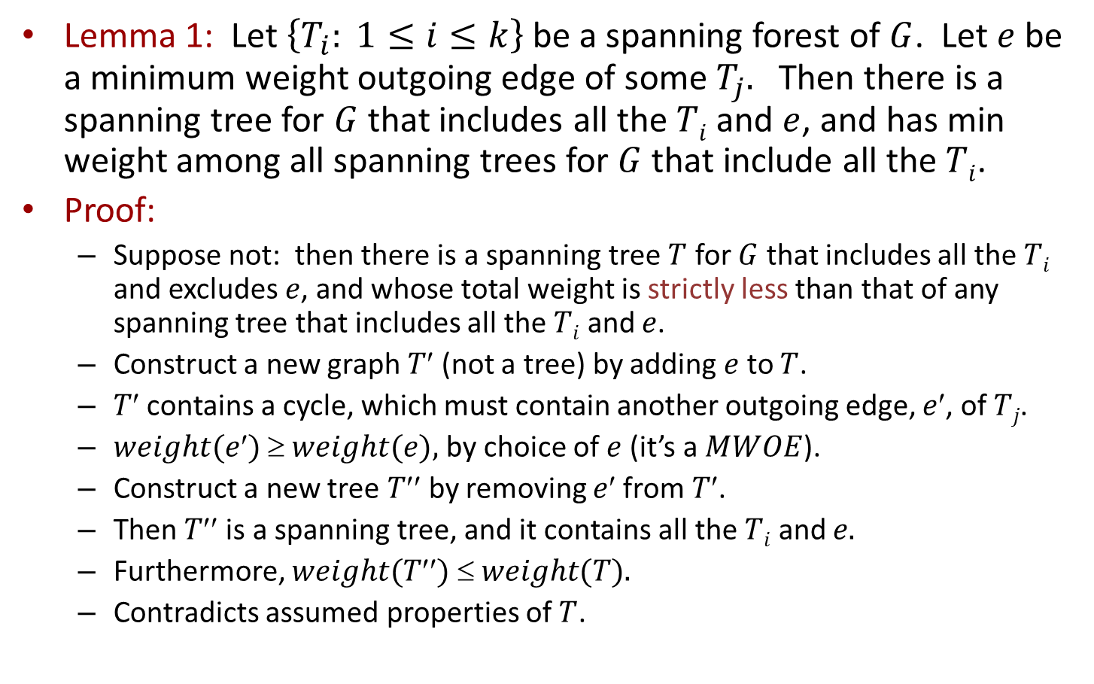
Why this works
Lemma 1: Let $\left\{T_{i}: 1≤i≤k\right\}$be a spanning forest of $G$. Let $e$ be a minimum weight outgoing edge of some${ T}_{j}.$ Then there is a spanning tree for $G$ that includes all the $Ti$ and $e$, and has min weight among all spanning trees for $G$ that include all the $Ti$.
Proof:
Suppose not: then there is a spanning tree $T$ for $G$ that includes all the $Ti$ and excludes $e$, and whose total weight is strictly less than that of any spanning tree that includes all the $Ti$ and $e$.
Construct a new graph $T$ (not a tree) by adding $e$ to $T$.
$T$contains a cycle, which must contain another outgoing edge, $e$, of $Tj$.
$weight(e)  weight(e),$by choice of $e$ (it’s a $MWOE$).
Construct a new tree $T$by removing $e$from $T$.
Then $T$is a spanning tree, and it contains all the $Ti$ and $e.$
Furthermore, $weight(T)  weight(T).$
Contradicts assumed properties of $T$.
Notes:
Similar argument to one commonly used in the sequential case.

Slide 34
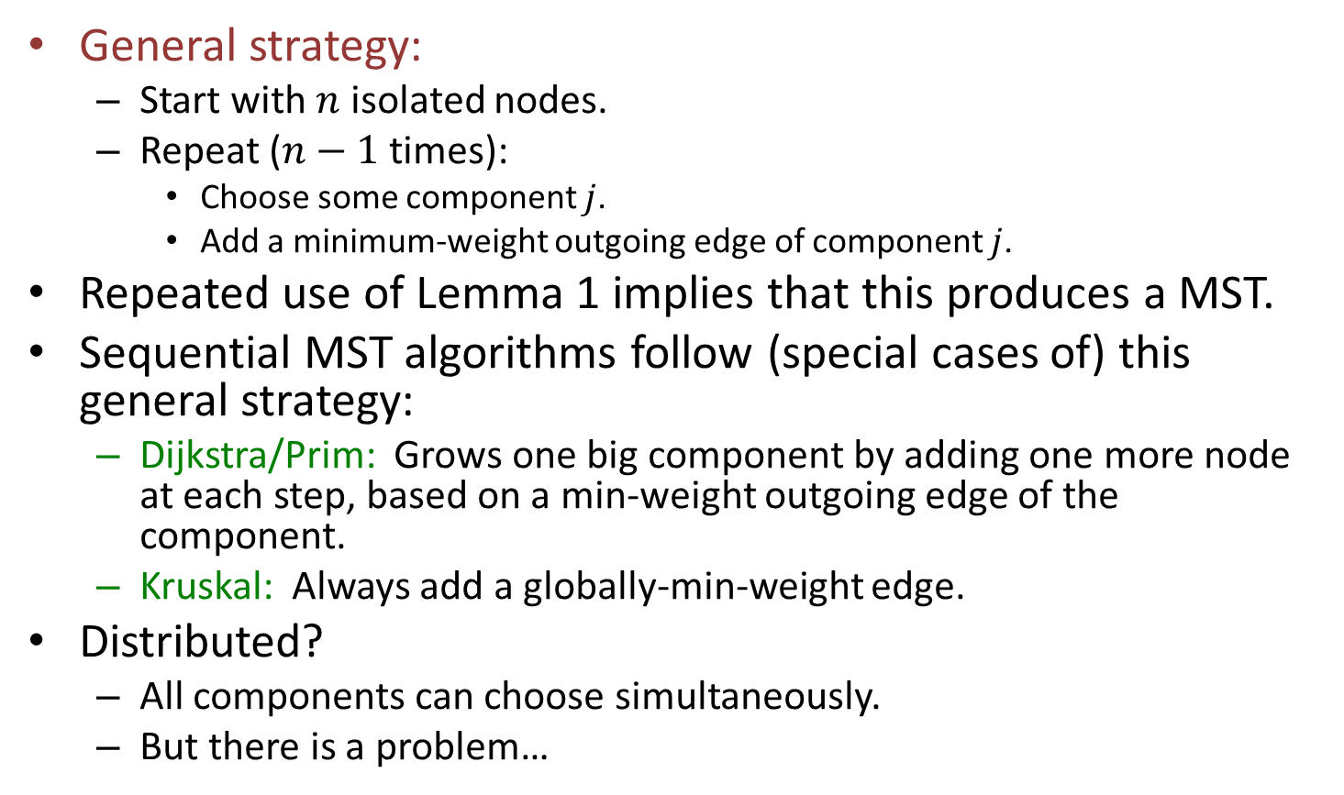
Minimum spanning tree algorithms
General strategy:
Start with $n$ isolated nodes.
Repeat ($n−1$ times):
Choose some component $j$.
Add a minimum-weight outgoing edge of component $j$.
Repeated use of Lemma 1 implies that this produces a MST.
Sequential MST algorithms follow (special cases of) this general strategy:
Dijkstra/Prim: Grows one big component by adding one more node at each step, based on a min-weight outgoing edge of the component.
Kruskal: Always add a globally-min-weight edge.
Distributed?
All components can choose simultaneously.
But there is a problem…

Slide 35
We can get cycles:
a
1
1
c
1
b

Slide 36
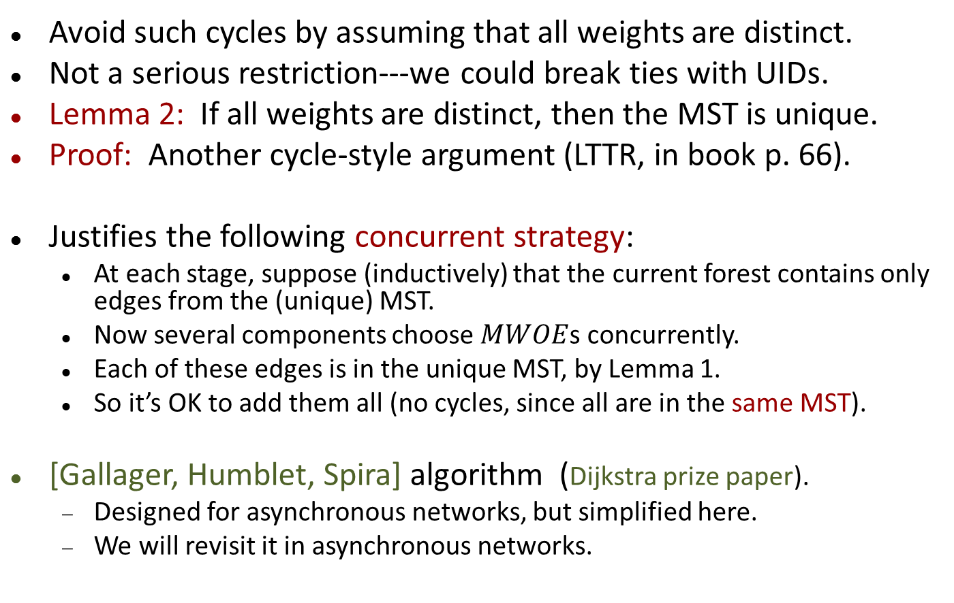
Minimum spanning tree
Avoid such cycles by assuming that all weights are distinct.
Not a serious restriction---we could break ties with UIDs.
Lemma 2: If all weights are distinct, then the MST is unique.
Proof: Another cycle-style argument (LTTR, in book p. 66).
Justifies the following concurrent strategy:
At each stage, suppose (inductively) that the current forest contains only edges from the (unique) MST.
Now several components choose $MWOE$s concurrently.
Each of these edges is in the unique MST, by Lemma 1.
So it’s OK to add them all (no cycles, since all are in the same MST).
[Gallager, Humblet, Spira] algorithm (Dijkstra prize paper).
Designed for asynchronous networks, but simplified here.
We will revisit it in asynchronous networks.

Slide 37
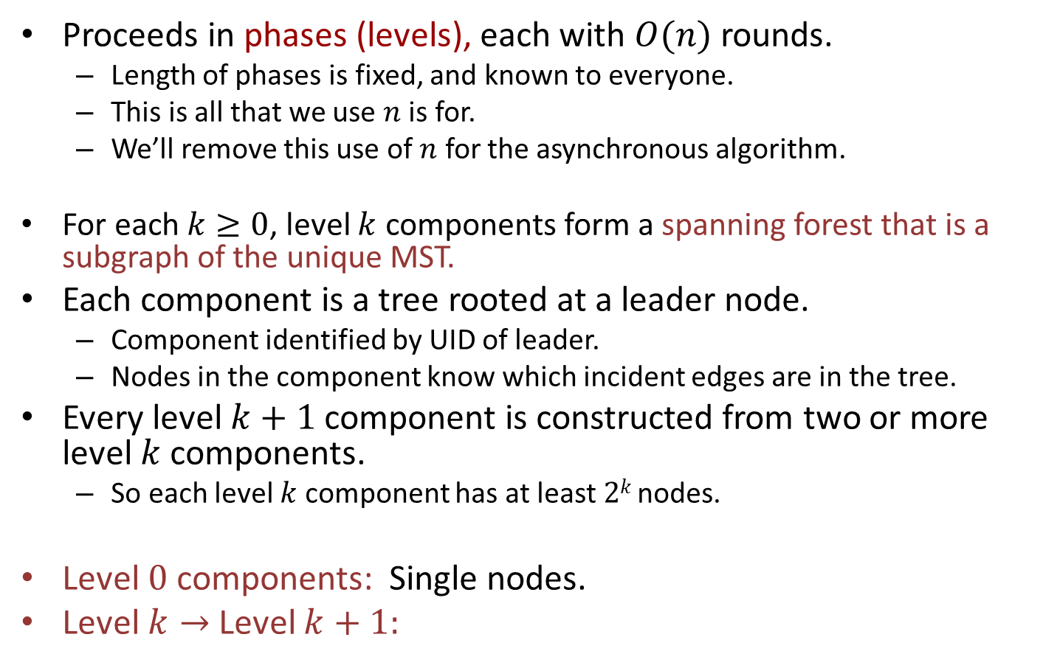
GHS distributed MST algorithm
Proceeds in phases (levels), each with $O(n)$ rounds.
Length of phases is fixed, and known to everyone.
This is all that we use $n$ is for.
We’ll remove this use of $n$ for the asynchronous algorithm.
For each $k≥0$, level $k$ components form a spanning forest that is a subgraph of the unique MST.
Each component is a tree rooted at a leader node.
Component identified by UID of leader.
Nodes in the component know which incident edges are in the tree.
Every level $k+1$ component is constructed from two or more level $k$ components.
So each level $k$ component has at least $2k$ nodes.
Level $0$ components: Single nodes.
Level $k→$Level $k+1:$
Notes:
I’m using invariant-style claims to explain how the algorithm works. That’s a good way to think about distributed algorithms.

Slide 38

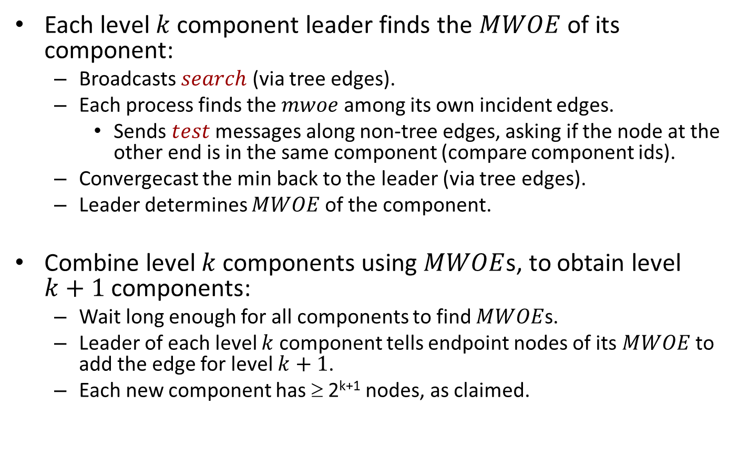
Level $k→$ Level $k+1$
Each level $k$ component leader finds the $MWOE$ of its component:
Broadcasts $search$ (via tree edges).
Each process finds the $mwoe$ among its own incident edges.
Sends $test$ messages along non-tree edges, asking if the node at the other end is in the same component (compare component ids).
Convergecast the min back to the leader (via tree edges).
Leader determines $MWOE$of the component.
Combine level $k$ components using $MWOE$s, to obtain level $k+1$ components:
Wait long enough for all components to find $MWOE$s.
Leader of each level $k$ component tells endpoint nodes of its $MWOE$ to add the edge for level $k+1$.
Each new component has ≥ 2^{k+1} nodes, as claimed.
Notes:
mwoe refers simply to the min weight edge that is outgoing from the component, from among the edges incident on the given node.
The leader informs the endpoints of the mwoe by sending a message along the appropriate branch of the component tree.

Slide 39

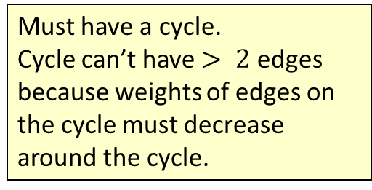
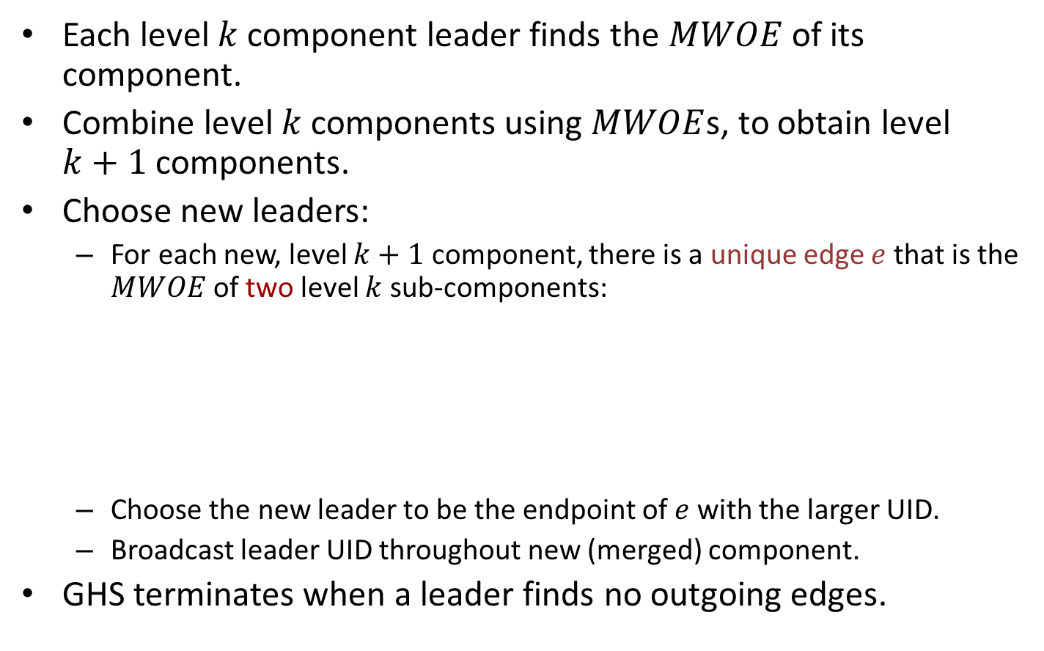
Level $k$ → Level $k+1$
Each level $k$ component leader finds the $MWOE$of its component.
Combine level $k$ components using $MWOE$s, to obtain level $k+1$components.
Choose new leaders:
For each new, level $k+1$ component, there is a unique edge $e$ that is the $MWOE$ of two level $k$ sub-components:
Choose the new leader to be the endpoint of $e$ with the larger UID.
Broadcast leader UID throughout new (merged) component.
GHS terminates when a leader finds no outgoing edges.
Must have a cycle.
Cycle can’t have $> 2$ edges because weights of edges on the cycle must decrease around the cycle.
e
Notes:
Actually, must have exactly one cycle, with other paths leading into the cycle.
Endpoints of this edge can recognize it, so elect a new leader without any global coordination.

Slide 40

Note on synchronization
This simplified version of GHS is designed to work with component levels synchronized.
Difficulties can arise when they get out of synch (as we’ll see later).
In particular, $test$messages are supposed to compare leader UIDs to determine whether endpoints are in the same component.
This requires that the node being queried has up-to-date UID information.

Slide 41
Minimum spanning tree
4
g
a
d
12
5
2
i
c
9
10
1
f
k
0
b
8
3
7
e
13
11
j
h
6
Notes:
This is the original graph G. Initially, all 11 nodes form separate level 0 components.

Slide 42
Minimum spanning tree
4
g
a
d
12
5
2
i
c
9
10
1
f
k
0
b
8
3
7
e
13
11
j
h
6
Notes:
This is the final answer---the unique MST.

Slide 43
Minimum spanning tree
4
g
a
d
12
5
2
i
c
9
10
1
f
k
0
b
8
3
7
e
13
11
j
h
6
Notes:
Suppose component a finds its MWOE, which is its only incident edge, with weight 12.
The dot at one end is supposed to indicate that it’s a’s mwoe.

Slide 44
Minimum spanning tree
4
g
a
d
12
5
2
i
c
9
10
1
f
k
0
b
8
3
7
e
13
11
j
h
6
Notes:
c now finds its MWOE, which is the one with weight 0.
It’s also b’s MWOE.
Hence the two-sided dots.

Slide 45
Minimum spanning tree
4
g
a
d
12
5
2
i
c
9
10
1
f
k
0
b
8
3
7
e
13
11
j
h
6
Notes:
Everyone finds their MWOEs. They are all marked in blue.
The dots on the edges indicate the nodes that decide this is their mwoe.

Slide 46
Minimum spanning tree
4
g
a
d
12
5
2
i
c
9
10
1
f
k
0
b
8
3
7
e
13
11
j
h
6
Notes:
Adding in all the blue edges, we obtain three level 1 components.
The unique 2-directional edges within the level 1 three components are the ones
labelled 0, 1, and 7 respectively.
These have dots at both endpoints.
The larger endpoints of these edges, c, e, and j, becomes the leaders of the components.

Slide 47




Minimum spanning tree
4
g
a
d
$$∞$$
12
5
$$∞$$
2
9
i
c
9
10
1
f
$$∞$$
k
0
$$∞$$
8
b
3
7
e
13
11
11
j
h
6
Notes:
This illustrates the first step of the search for the MWOE in the three components---
where the leaves (a, b, g, f, h, k) send their mwoe info.
h’s mwoe is 11, sends it toward the leader e of the middle component on the tree edges
f’s mwoe is 9, sends it toward the leader on the tree edges.
Nodes a, b, g, k discover they have no outgoing edges, so send null (infinity) messages.
Here we are writing the null messages as just infinity instead of \bot as before.
It makes sense since everyone is taking the min along the way.
Other nodes (c, d, e, i, j) are waiting to hear from their children (convergecast) before
sending or incorporating their own mwoe info.

Slide 48
Minimum spanning tree
4
g
a
d
12
5
2
i
c
9
10
1
f
5
k
0
9
b
8
3
7
e
13
11
j
h
6
Notes:
Now the second step.
Node c, having collected the null mwoe info from a and b, determines its own mwoe,
the 5-edge and decides that it’s the MWOE for the entire component.
In the middle component, d computes its own mwoe, the 5 edge, and sends the info to e.
It sends this because it’s the min of 5, and the received 9 and infinity. Convergecast…
In the third component, i determines its own mwoe, the 9-edge, and sends it to j.

Slide 49
Minimum spanning tree
4
g
a
d
12
5
2
i
c
9
10
1
f
k
0
b
8
3
7
e
13
11
j
h
6
Notes:
e identifies its mwoe as the weight-8 edge and therefore identifies the overall MWOE
of the component as the weight-5 edge.
J identifies its mwoe as the weight-11 edge and therefore identifies the overall MWOE
of the component as the weight-9-edge.

Slide 50
Minimum spanning tree
4
g
a
d
12
5
2
i
c
9
10
1
f
ok
k
0
ok
b
8
3
7
e
13
11
j
h
6
Notes:
E and j send ok messages to d and I respectivelly, since these are the endpoints
of the MWOEs

Slide 51
Minimum spanning tree
4
g
a
d
12
5
2
i
c
9
10
1
f
k
0
b
8
3
7
e
13
11
j
h
6
Notes:
D and I then mark their adjacent mwoes (the 5 edge and the 9 edge, respectively)
as the component MWOEs.

Slide 52
Minimum spanning tree
4
g
a
d
12
5
2
i
c
9
10
1
f
k
0
b
8
3
7
e
13
11
j
h
6
Notes:
Now the algorithm combines the three level 1 components to get the (single)
level 2 component.
The common edge now is the one with weight 5. The new leader is d.

Slide 53






Minimum spanning tree
4
g
a
d
$$∞$$
12
5
2
$$∞$$
i
9
$$∞$$
10
c
1
f
k
0
$$∞$$
b
8
3
7
$$∞$$
e
13
$$∞$$
11
j
h
6
Notes:
Fanning in null messages.

Slide 54



Minimum spanning tree
4
g
a
d
12
5
$$∞$$
2
i
c
9
10
1
f
$$∞$$
$$∞$$
k
0
b
8
3
7
e
13
11
j
h
6
Notes:
Still fanning

Slide 55

Minimum spanning tree
4
g
a
d
12
5
$$∞$$
2
i
c
9
10
1
f
k
0
b
8
3
7
e
13
11
j
h
6
Notes:
Still fanning

Slide 56
Minimum spanning tree
4
g
a
d
12
5
2
i
c
9
10
1
f
k
0
b
8
3
7
e
13
11
j
h
6
Notes:
Now d has all the info, knows that there are no new outgoing edges, so the
algorithm terminates.

Slide 57
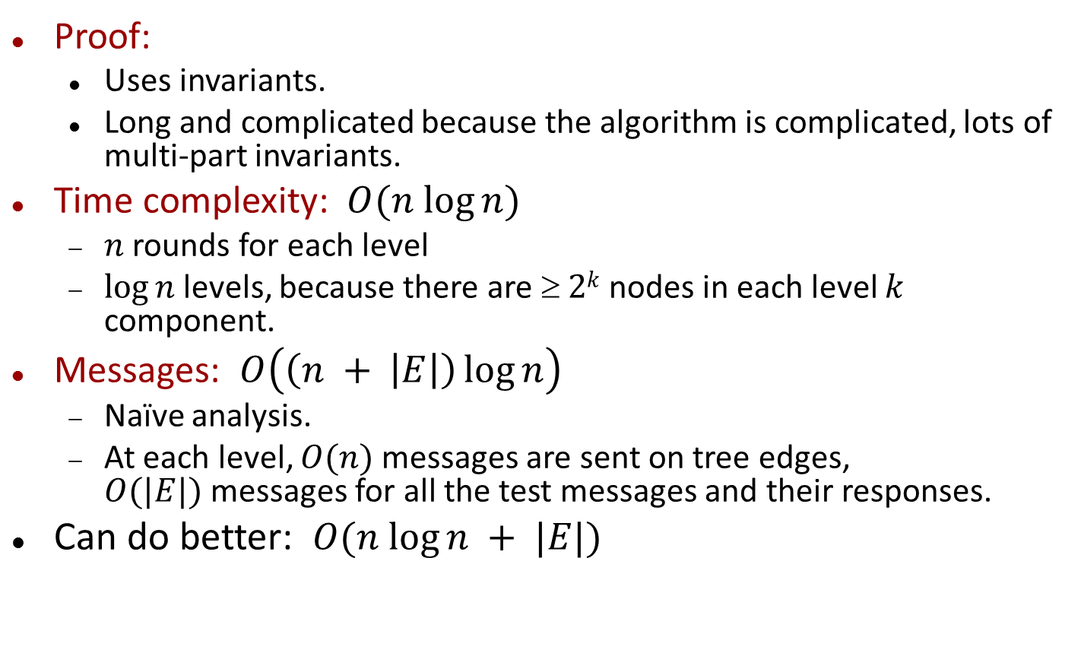
Proof, Analysis
Proof:
Uses invariants.
Long and complicated because the algorithm is complicated, lots of multi-part invariants.
Time complexity: $O(n log⁡n)$
$n$ rounds for each level
$log⁡n$levels, because there are $ 2k$nodes in each level $k$ component.
Messages: $O\left(\left(n + \left|E\right|\right)\log{n}\right)$
Naïve analysis.
At each level, $O(n)$messages are sent on tree edges, $O(|E|)$messages for all the test messages and their responses.
Can do better: $O(n log⁡n + |E|)$

Slide 58
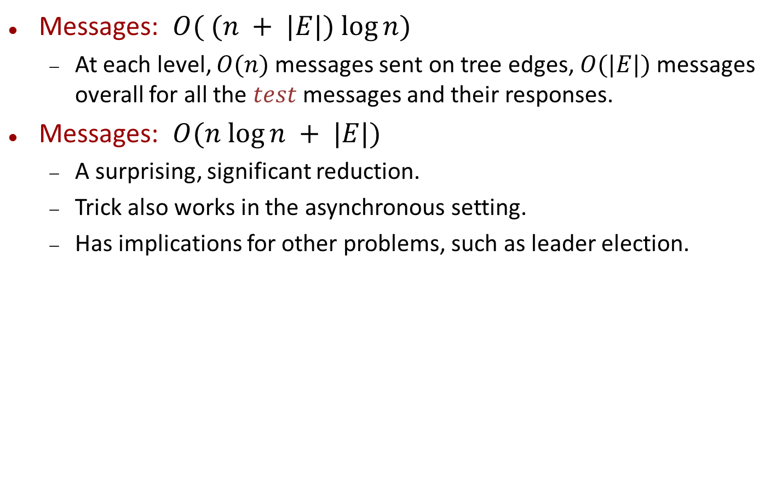
Message Complexity Bound
Messages: $O( (n + |E|) log⁡n)$
At each level, $O(n)$ messages sent on tree edges, $O(|E|)$messages overall for all the $test$messages and their responses.
Messages: $O(n log⁡n + |E|)$
A surprising, significant reduction.
Trick also works in the asynchronous setting.
Has implications for other problems, such as leader election.

Slide 59
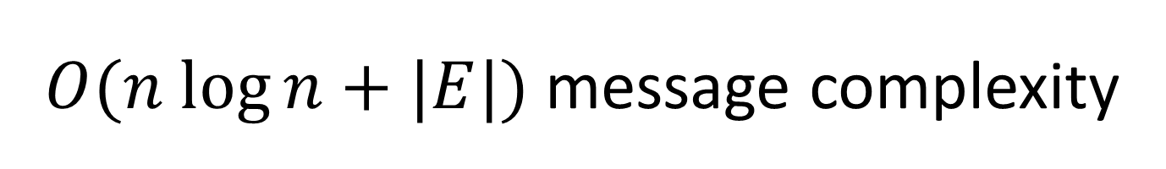
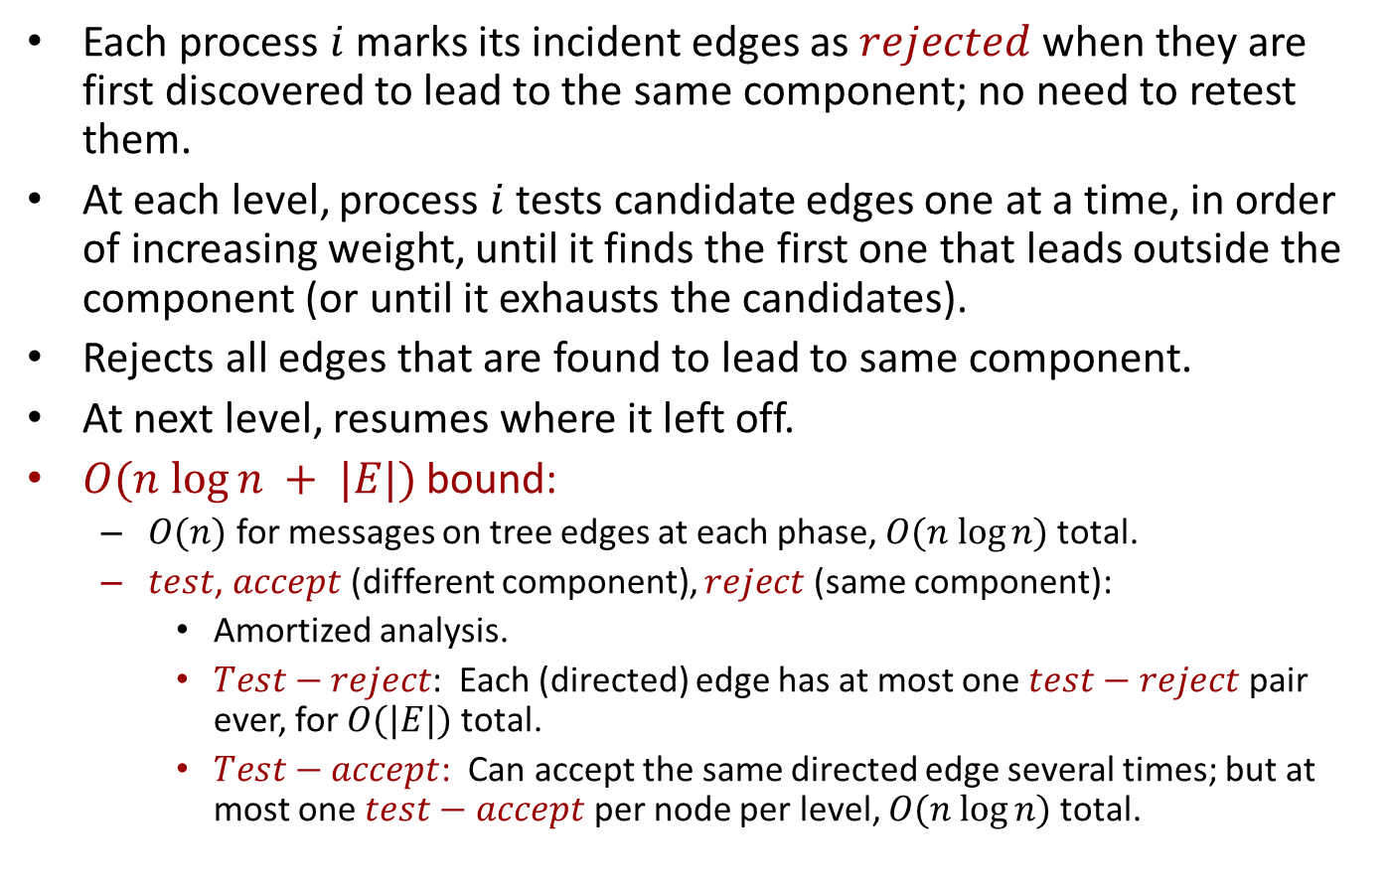
$O(n log⁡n+|E|)$message complexity
Each process $i$marks its incident edges as $rejected$ when they are first discovered to lead to the same component; no need to retest them.
At each level, process $i$tests candidate edges one at a time, in order of increasing weight, until it finds the first one that leads outside the component (or until it exhausts the candidates).
Rejects all edges that are found to lead to same component.
At next level, resumes where it left off.
$O(n log⁡n + |E|)$bound:
$O(n)$ for messages on tree edges at each phase, $O(n log⁡n)$total.
$test$, $accept$ (different component), $reject$ (same component):
Amortized analysis.
$Test−reject$: Each (directed) edge has at most one $test−reject$ pair ever, for $O(|E|)$total.
$Test−accept$: Can accept the same directed edge several times; but at most one $test−accept$ per node per level, $O(n log⁡n)$total.

Slide 60
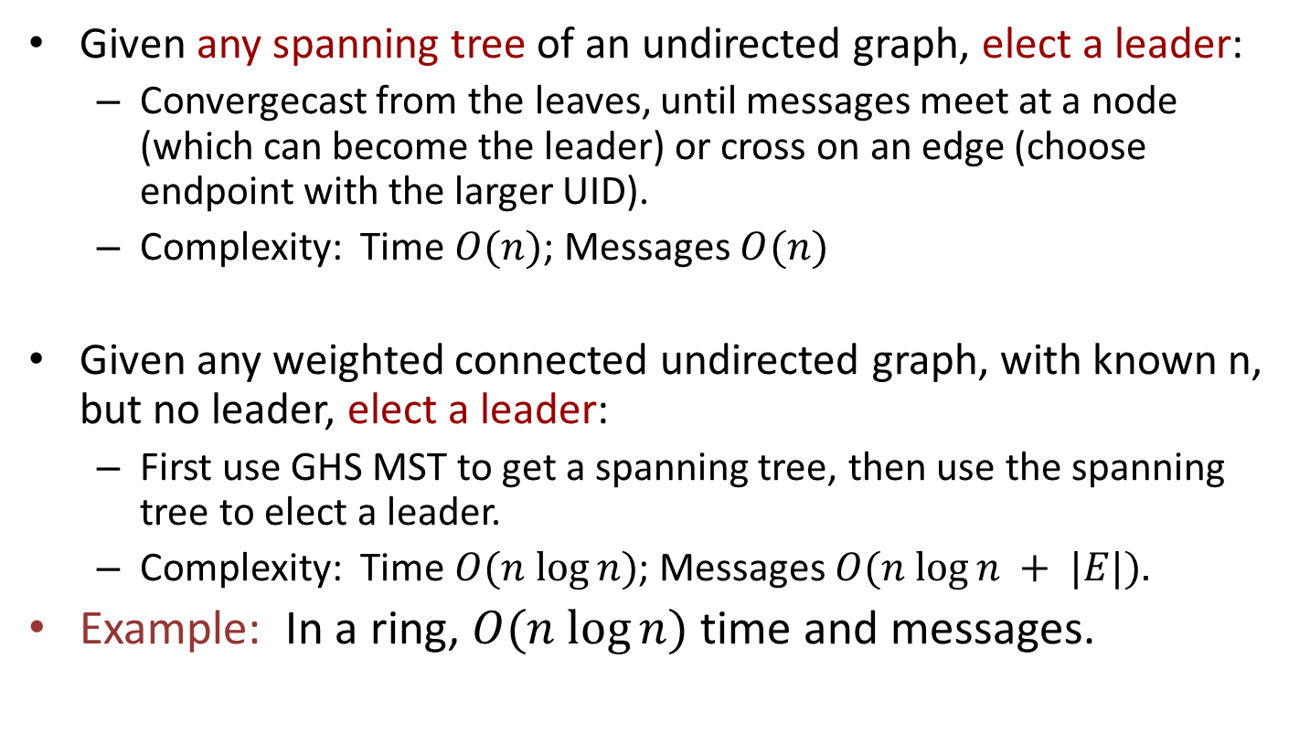
Some implications
Given any spanning tree of an undirected graph, elect a leader:
Convergecast from the leaves, until messages meet at a node (which can become the leader) or cross on an edge (choose endpoint with the larger UID).
Complexity: Time $O(n)$; Messages $O(n)$
Given any weighted connected undirected graph, with known n, but no leader, elect a leader:
First use GHS MST to get a spanning tree, then use the spanning tree to elect a leader.
Complexity: Time $O(n log⁡n)$; Messages $O(n log⁡n + |E|).$
Example: In a ring, $O(n log⁡n)$time and messages.
Notes:
For the ring example, we typically wouldn’t have weights, but we could invent some based on the endpoints’ UIDs.
Recall that we need unique weights.
Actually, the GHS algorithm produces a leader “for free”, without fanning in
Discuss in more detail how to convergecast on an un-oriented tree---wait to hear from all but one neighbor before sending to remaining neighbor.

Slide 61
Discussion
Q: Where/how have we use synchrony so far?
Leader election
Breadth-first search
Shortest paths
Minimum spanning tree
We will see these algorithms again
in the asynchronous setting.
Notes:
Leader election: To help with termination, if we have info about the graph size (n or diam).
BFS: To keep the search synchronized.
Shortest-paths: Similar.
MST: To keep the levels straight.

Slide 62
Other graph problems…
We can define a distributed version of practically any graph problem: Maximal Independent Set (MIS), dominating set, graph coloring,…
Many of these have been well studied.
One more example today…
More next week…

Slide 63
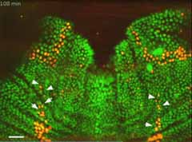
Maximal Independent Set
Notes:
The picture in the lower right is from a biology paper, in Science, which studies a maximal independent set problem that arises in the development of the fruit fly.

Slide 64
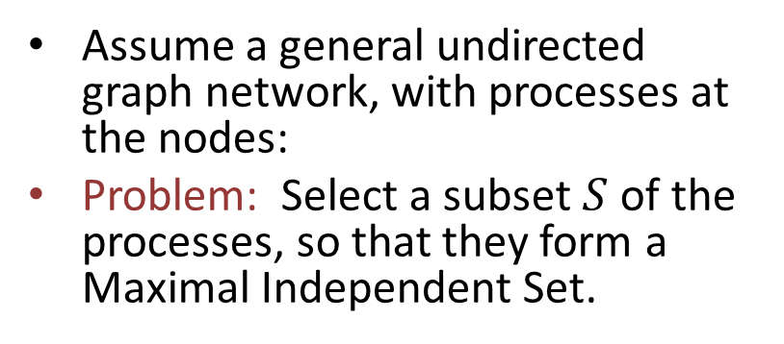
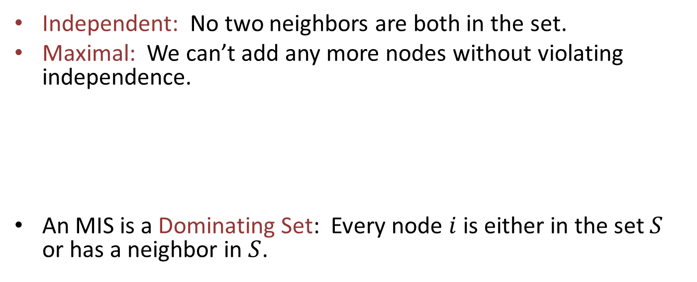
Maximal Independent Set (MIS)
Assume a general undirected graph network, with processes at the nodes:
Problem: Select a subset $S$ of the processes, so that they form a Maximal Independent Set.
Independent: No two neighbors are both in the set.
Maximal: We can’t add any more nodes without violating independence.
An MIS is a Dominating Set: Every node $i$ is either in the set $S$ or has a neighbor in $S$.
Notes:
If i is not in the set and has no neighbors in the set, we could add i to the set and the result would be a larger independent set. This would contradict maximality.

Slide 65
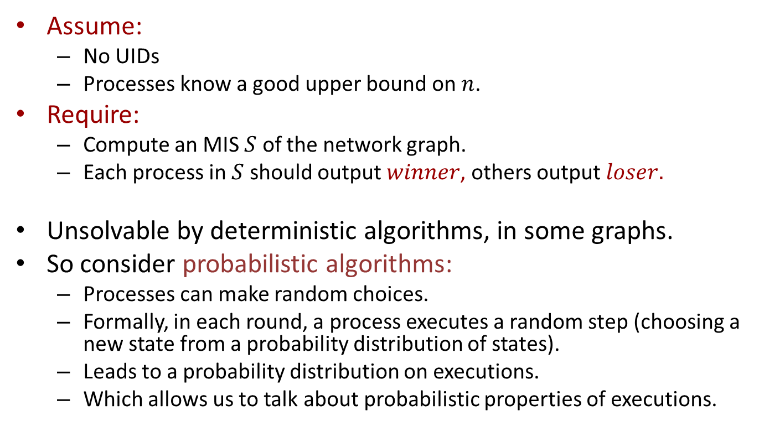
Distributed MIS Problem
Assume:
No UIDs
Processes know a good upper bound on $n$.
Require:
Compute an MIS $S$ of the network graph.
Each process in $S$ should output $winner$, others output $loser.$
Unsolvable by deterministic algorithms, in some graphs.
So consider probabilistic algorithms:
Processes can make random choices.
Formally, in each round, a process executes a random step (choosing a new state from a probability distribution of states).
Leads to a probability distribution on executions.
Which allows us to talk about probabilistic properties of executions.
Notes:
A bound on the local degree would do.
Unsolvability uses arguments like the impossibility for symmetry-breaking in the ring.
The probability distribution can depend on the current state, see book p. 22.

Slide 66
Applications of Distributed MIS
Communication networks:
Selected processes can take charge of communication, convey information to all the other processes.
Wireless network transmission:
Suppose MIS processes transmit messages, others listen.
A transmitted message reaches neighbors in the graph.
Assume a receiver actually receives everything that reaches it (ignoring the possibility of message collisions).
Independence guarantees that no two neighbors transmit, so all messages are received by all transmitters’ neighbors.
Maximality implies that everyone either transmits or receives a message.
Developmental biology:
Distinguish cells in fruit fly’s nervous system to become “Sensory Organ Precursor” cells [Afek, Alon,…Bar-Joseph].
Notes:
Communication networks: Sort of a backbone network, some nodes take responsibility for informing all other nodes.
----------
Wireless network transmission: Can consider this as a special case of a communication network problem.
Some strategy, like backoff and retransmission, probabilistic transmission, coding, is needed to ensure all the messages get received.
Here we’re even allowing multiple messages to be received at once by the same receiver.
Since an MIS is a Dominating Set, every node i is either in the set or a neighbor is in the set. That implies that process i either transmits or receives something.
This is assuming that the graph is connected, so every MIS paper actually has some (non-MIS) neighbor to receive its’ message.
----------
Science magazine paper a couple of years ago, by Bar-Joseph et al. Experimental results show that in the development of the fly’s nervous system, certain cells are singled out as “Sensory Organ Precursor” cells. These form an MIS. The paper develops a theoretical distributed MIS algorithm whose behavior is consistent with what is observed experimentally. It’s somewhat similar to the algorithm I’m about to present, but it uses a strategy of waiting a random amount of time.

Slide 67
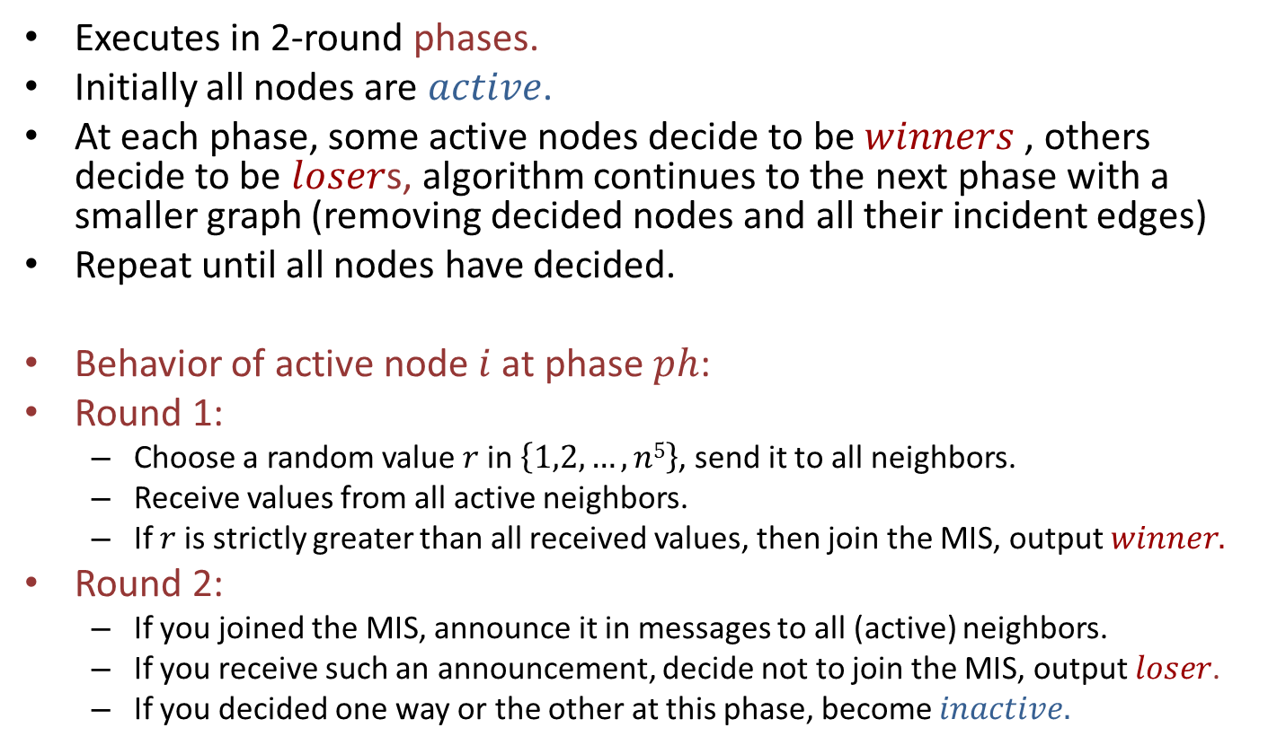
Luby’s MIS Algorithm
Executes in 2-round phases.
Initially all nodes are $active$.
At each phase, some active nodes decide to be $winners$ , others decide to be $loser$s, algorithm continues to the next phase with a smaller graph (removing decided nodes and all their incident edges)
Repeat until all nodes have decided.
Behavior of active node $i$ at phase $ph$:
Round 1:
Choose a random value $r$in $\left\{1,2,…,n5\right\}$, send it to all neighbors.
Receive values from all active neighbors.
If $r$is strictly greater than all received values, then join the MIS, output $winner.$
Round 2:
If you joined the MIS, announce it in messages to all (active) neighbors.
If you receive such an announcement, decide not to join the MIS, output $loser$.
If you decided one way or the other at this phase, become $inactive.$
Notes:
Range is chosen to be large enough set so it’s likely that all numbers are distinct.
Round 1:
Sending to all neighbors means sending on all outgoing ports. The node is not really sure whom the ports are connected to, since we have no UIDs.
Receiving from all active neighbors just means to receive whatever arrives at that round. These will be just the messages from the active neighbors.
I’m not having the losers announce that they are losers. The nodes don’t actually know at this point which neighbors are in and out (and they have no UIDs to use to name the neighbors anyway). But it will just happen that the graph gets reduced at the next phase, because the decided nodes will just stop participating.

Slide 68

Properties of Luby’s Algorithm
Theorem: If LubyMIS ever terminates, it produces an MIS.
Theorem: With probability $1$, it eventually terminates; the expected number of rounds until termination is $O(log⁡n).$
Proofs: In a minute…

Slide 69
Example
All nodes start out identical.

Slide 70
Example
7
8
1
16
10
11
2
9
13
5
Everyone chooses an ID.

Slide 71
Example
7
8
1
16
10
11
2
9
13
5
Processes that chose 16 and 13 are in.
Processes that chose 11, 5, 2, and 10 are out.

Slide 72
7
18
4
12
Undecided (gray) processes choose new IDs.

Slide 73
7
18
4
12
Processes that chose 12 and 18 are in.
Process that chose 7 is out.

Slide 74
12
Undecided (gray) process chooses a new ID.

Slide 75
12
It’s in.

Slide 76
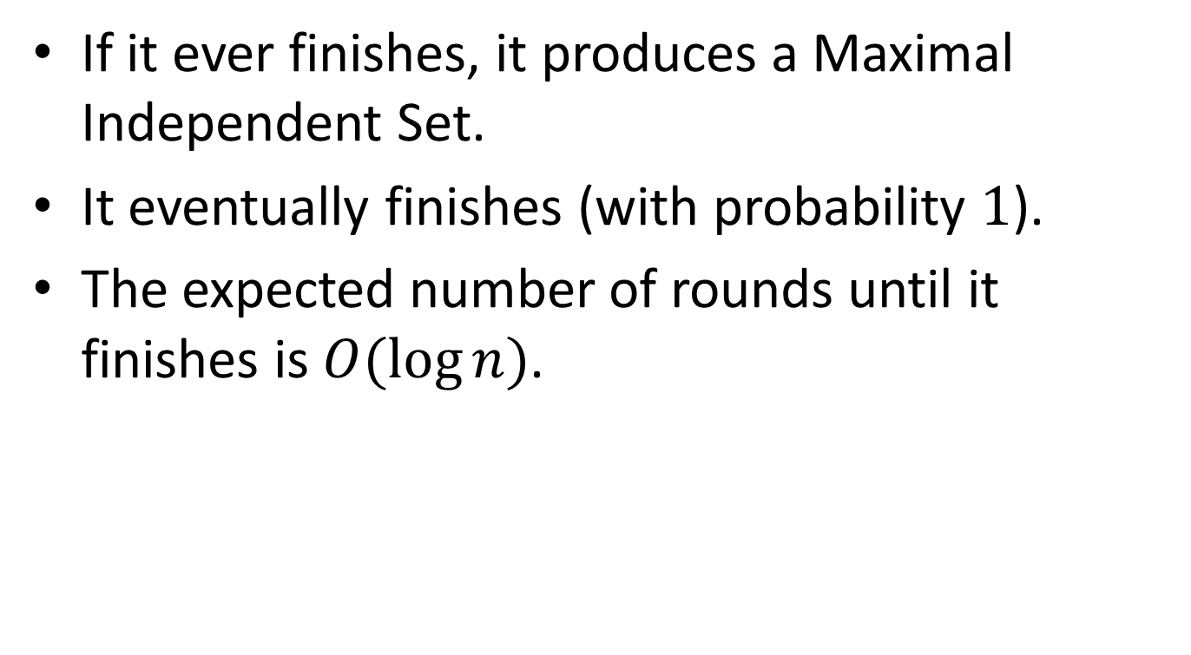
Properties of Luby’s algorithm
If it ever finishes, it produces a Maximal Independent Set.
It eventually finishes (with probability $1$).
The expected number of rounds until it finishes is $O(log⁡n)$.
Notes:
Finishing with probability 1: We consider how the execution unfolds. We have probabilistic choices, which give rise to a probability distribution on executions. With respect to that probability distribution, we get termination with probability 1.

Slide 77
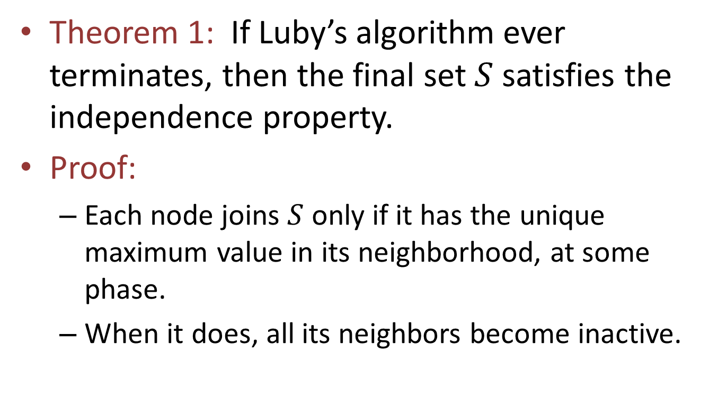
Independence
Theorem 1: If Luby’s algorithm ever terminates, then the final set $S$ satisfies the independence property.
Proof:
Each node joins $S$ only if it has the unique maximum value in its neighborhood, at some phase.
When it does, all its neighbors become inactive.
Notes:
Not a probabilistic claim.

Slide 78
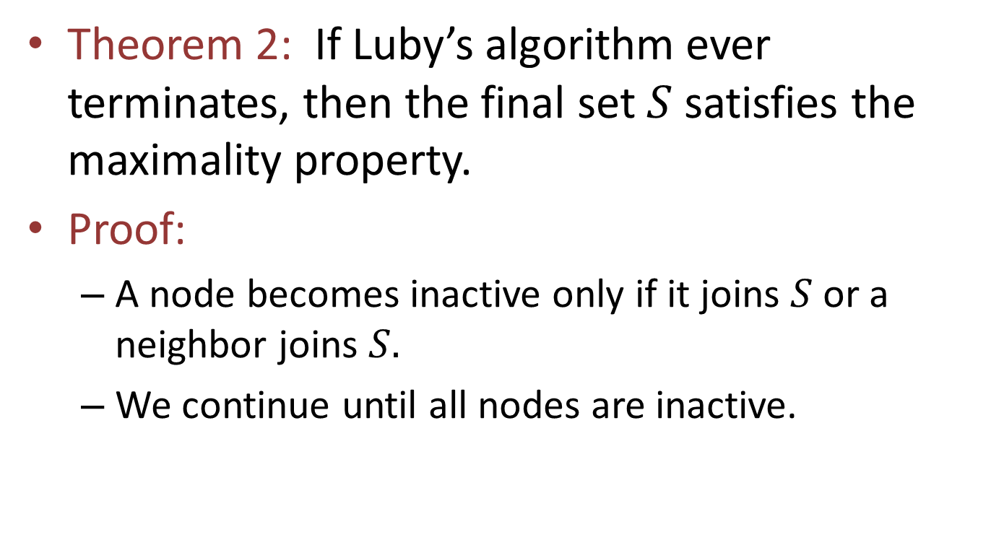
Maximality
Theorem 2: If Luby’s algorithm ever terminates, then the final set $S$ satisfies the maximality property.
Proof:
A node becomes inactive only if it joins $S$ or a neighbor joins $S.$
We continue until all nodes are inactive.
Notes:
Not a probabilistic claim.

Slide 79
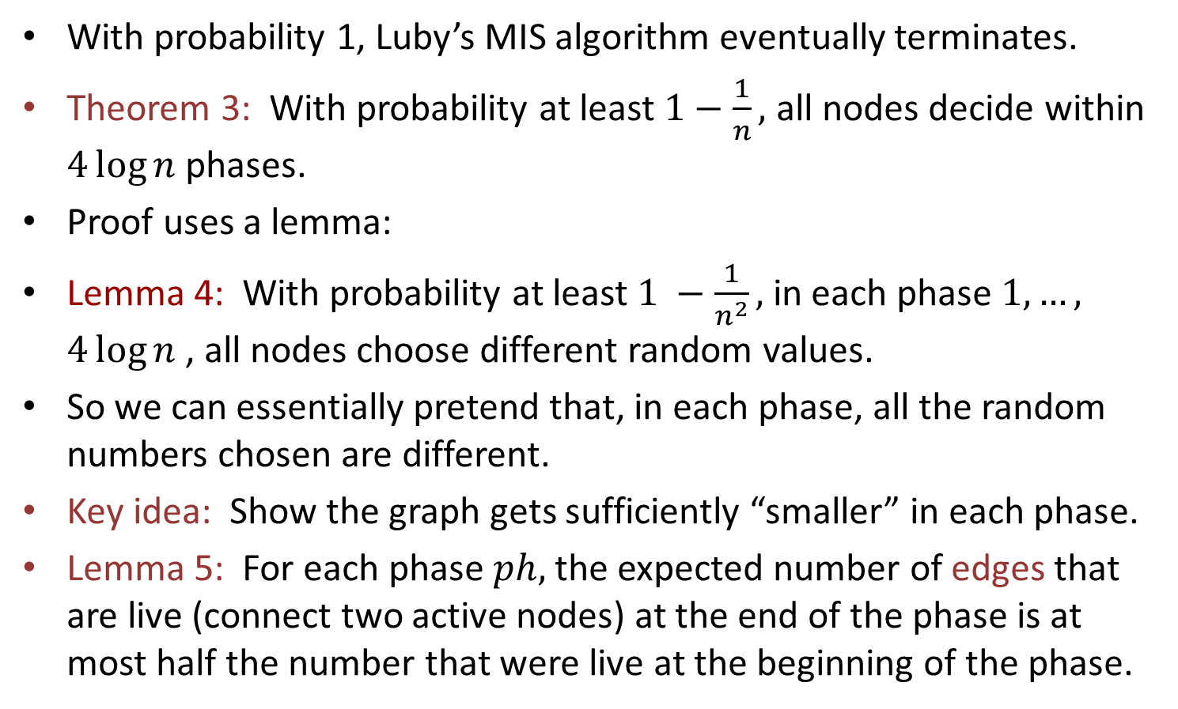
Termination
With probability 1, Luby’s MIS algorithm eventually terminates.
Theorem 3: With probability at least $1−\frac{1}{n},$ all nodes decide within $4\log{n }$phases.
Proof uses a lemma:
Lemma 4: With probability at least $1 −\frac{1}{n^{2}},$ in each phase $1,…,$ $4\log{n }$, all nodes choose different random values.
So we can essentially pretend that, in each phase, all the random numbers chosen are different.
Key idea: Show the graph gets sufficiently “smaller” in each phase.
Lemma 5: For each phase $ph,$ the expected number of edges that are live (connect two active nodes) at the end of the phase is at most half the number that were live at the beginning of the phase.
Notes:
What can students learn from this analysis?
A clever analysis, for a basic algorithm that has had a long history of more complicated analyses.
How basic probability techniques are used for a typical randomized distributed algorithm.
Union bounds, iterated expectation, Markov,…
Using union bounds for disjoint events
Breaking down edge death in terms of node wins.
Log n round bound because we decrease by ½ each time.
Getting unique ids WHP.
--------------------------------------------------------------------------------------------------------------------------------------
The expected number of rounds until termination is $O(log n).$
We prove something stronger, a high-probability bound.
This implies eventual termination with prob 1.
We can pretend they are distinct. The exceptional case can be handled at the end using a union bound.
Lemma 5 is conditioning on a particular execution through the previous phases, leading to a particular graph of active nodes and live edges.

Slide 80
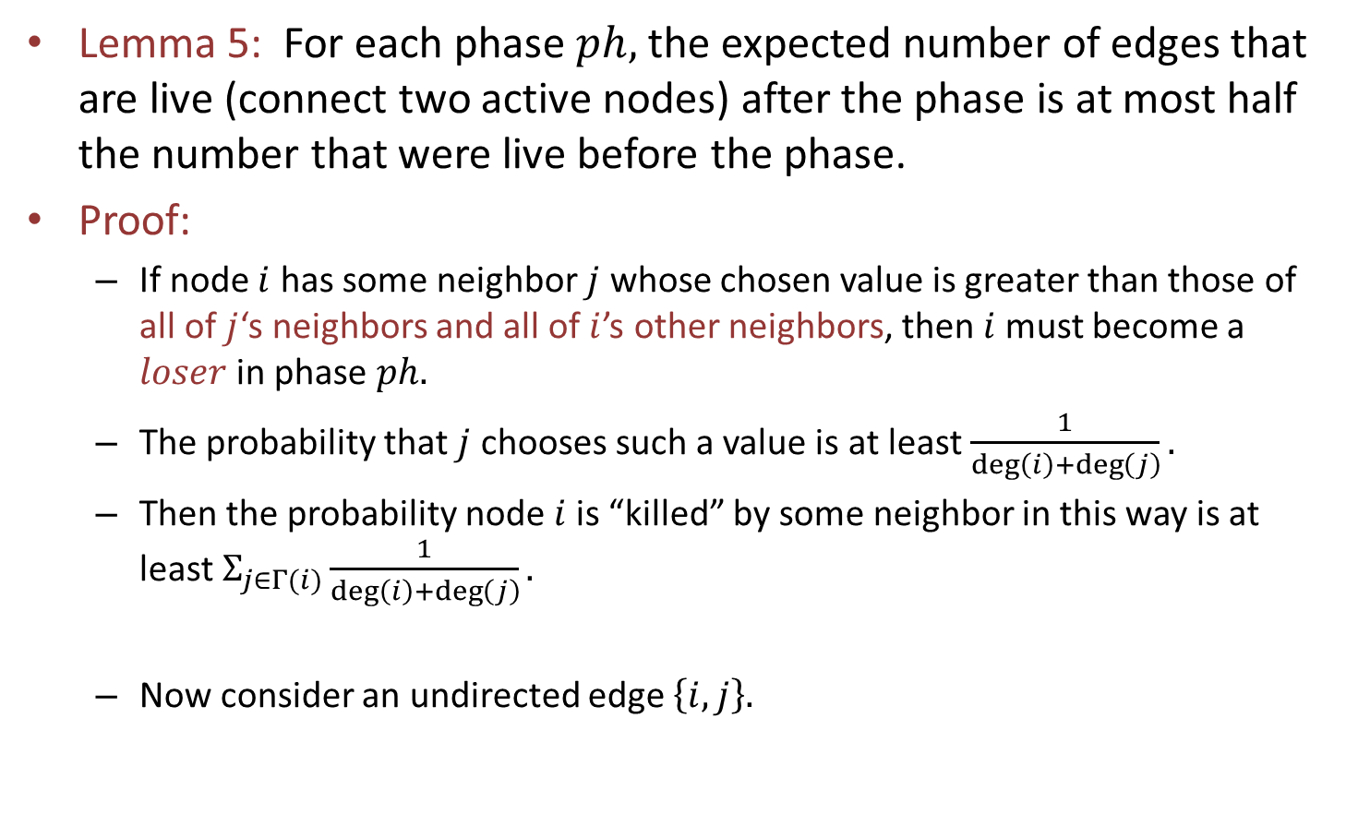


Termination
Lemma 5: For each phase $ph,$ the expected number of edges that are live (connect two active nodes) after the phase is at most half the number that were live before the phase.
Proof:
If node $i$ has some neighbor $j$ whose chosen value is greater than those of all of $j$‘s neighbors and all of $i$’s other neighbors, then $i$must become a $loser$ in phase $ph.$
The probability that $j$ chooses such a value is at least $\frac{1}{\deg\left(i\right)+\deg\left(j\right)}.$
Then the probability node $i$is “killed” by some neighbor in this way is at least $Σ_{j∈Γ(i)}\frac{1}{\deg\left(i\right)+\deg\left(j\right)}.$
Now consider an undirected edge $\left\{i,j\right\}.$
$$i$$
$$j$$
Notes:
This is based on a new proof by Yves Metivier et al.
Yesterday we discovered an earlier paper with the same type of proof---by Aaron Windsor. Still have to read it…
This is a sufficient condition for deciding out. It’s somewhat pessimistic, but it works to give the needed bound.
This bound for j uses the fact that each of i and j is in the other’s neighbor set.
The summation is over the neighbors of i.
The reason that we can add is that the different terms refer to disjoint events: if one neighbor “kills” i than another one cannot.
Here I’m using the Gamma as an abbreviation for “nbrs”.
But we are trying to prove that a lot of edges die, not just nodes. So…

Slide 81
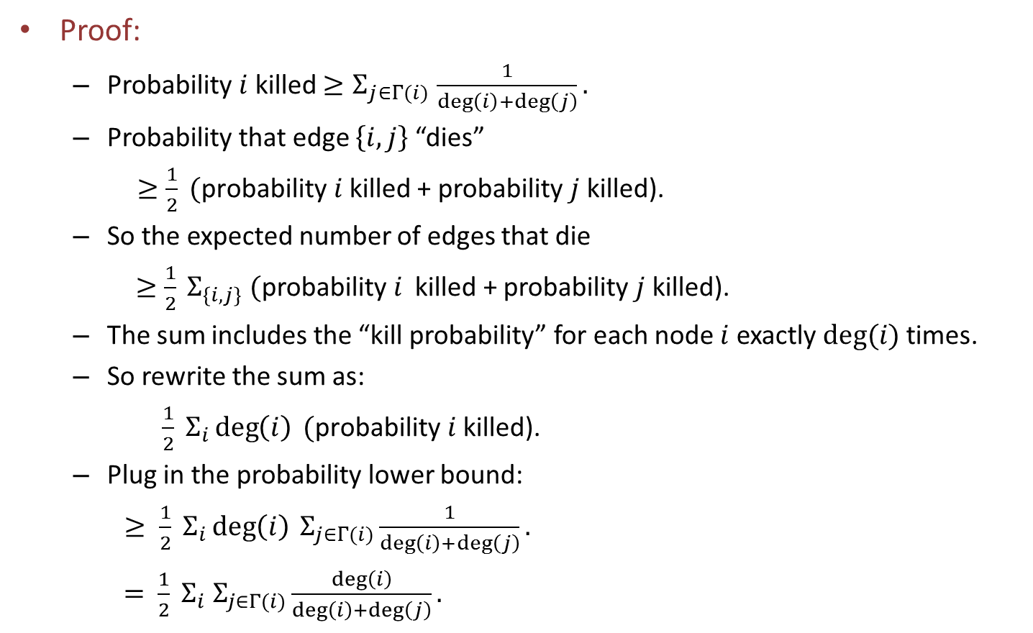
Termination, cont’d
Proof:
Probability $i$ killed ${≥Σ}_{j∈Γ(i)}\frac{1}{\deg\left(i\right)+\deg\left(j\right)}.$
Probability that edge $\left\{i,j\right\}$ “dies”
$≥\frac{1}{2} (\text{probability} i$killed + probability $j$ killed).
So the expected number of edges that die
$≥\frac{1}{2} Σ_{\left\{i,j\right\}} (\text{probability} i$ killed + probability $j$ killed).
The sum includes the “kill probability” for each node $i$ exactly $deg⁡(i)$ times.
So rewrite the sum as:
$\frac{1}{2} Σ_{i}\deg\left(i\right) (\text{probability} i \text{killed}\text{)}\text{.}$
Plug in the probability lower bound:
$≥ \frac{1}{2} Σ_{i}\deg\left(i\right) Σ_{j∈Γ(i)}\frac{1}{\deg\left(i\right)+\deg\left(j\right)}.$
$= \frac{1}{2} Σ_{i} Σ_{j∈Γ(i)}\frac{\deg\left(i\right)}{\deg\left(i\right)+\deg\left(j\right)}.$
Notes:
To say that an edge dies means that one of its endpoints gets killed. Then the endpoint would get removed from the graph, so also the edge would get removed.
Work out the first inequality:
I = event that i is killed, J = event that j is killed.
P(edge killed) = P(I) + P(J) – P(I \cap J), which must be \geq ½ (P(I) + P(J)). Check this by a simple case analysis based on whether I \geq J or not.
Stare at this sum…

Slide 82
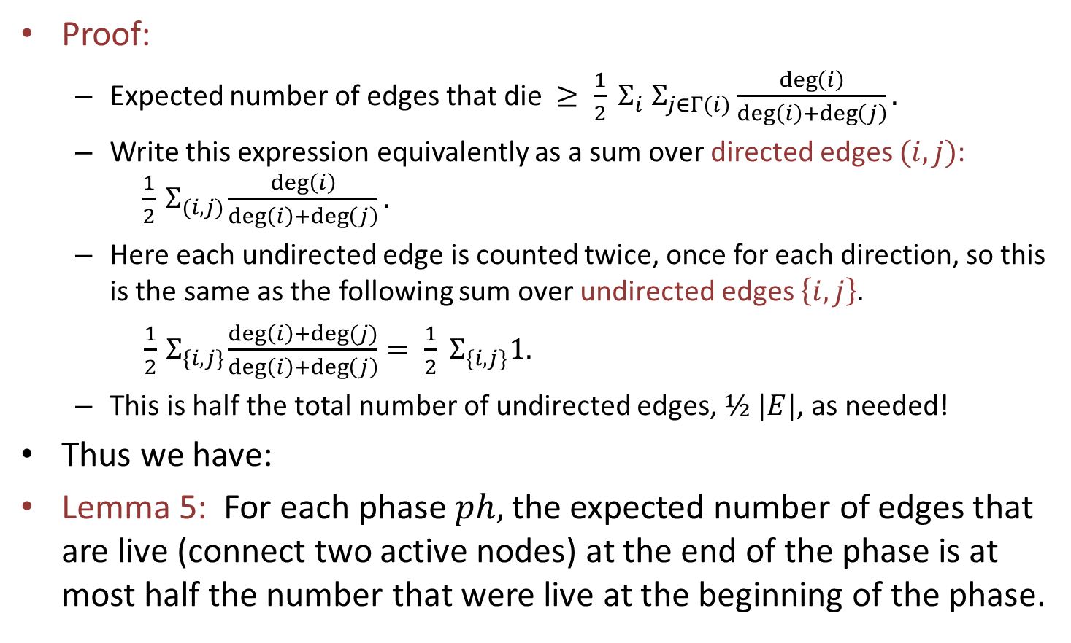
Termination, cont’d
Proof:
Expected number of edges that die $≥ \frac{1}{2} Σ_{i} Σ_{j∈Γ(i)}\frac{\deg\left(i\right)}{\deg\left(i\right)+\deg\left(j\right)}.$
Write this expression equivalently as a sum over directed edges $(i,j)$: $\frac{1}{2}{ Σ}_{(i,j)}\frac{\deg\left(i\right)}{\deg\left(i\right)+\deg\left(j\right)}.$
Here each undirected edge is counted twice, once for each direction, so this is the same as the following sum over undirected edges $\left\{i,j\right\}.$
$\frac{1}{2}{ Σ}_{\{i,j\}}\frac{\deg\left(i\right)+deg⁡(j)}{\deg\left(i\right)+\deg\left(j\right)}= \frac{1}{2}{ Σ}_{\{i,j\}}1.$
This is half the total number of undirected edges, $½ |E|$, as needed!
Thus we have:
Lemma 5: For each phase $ph,$ the expected number of edges that are live (connect two active nodes) at the end of the phase is at most half the number that were live at the beginning of the phase.
Notes:
We’re nearly done…
Recap: The expected number of edges that die is at least half of what we started with.
That is, we have proved Lemma 9: For each phase $ph,$ the expected number of edges that are live (connect two active nodes) at the end of the phase is at most $\frac{1}{2}$the number that were live at the beginning of the phase.

Slide 83
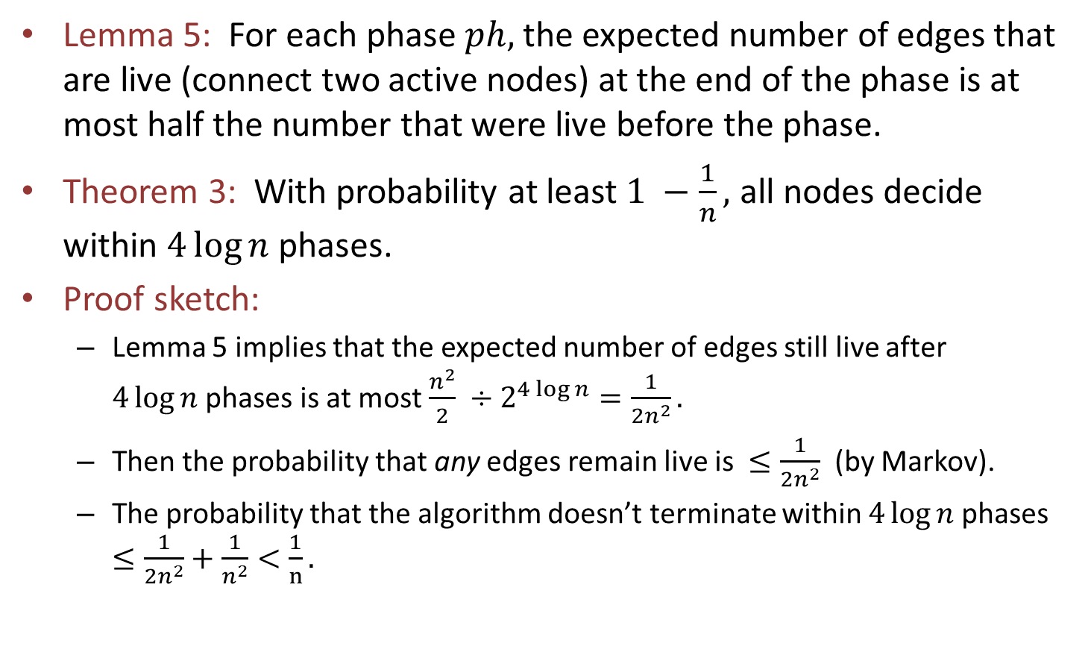
Termination, cont’d
Lemma 5: For each phase $ph,$ the expected number of edges that are live (connect two active nodes) at the end of the phase is at most half the number that were live before the phase.
Theorem 3: With probability at least $1 −\frac{1}{n},$ all nodes decide within $4\log{n }$phases.
Proof sketch:
Lemma 5 implies that the expected number of edges still live after $4\log{n }$phases is at most $\frac{n^{2}}{2}$ $÷2^{4\log{n}}=\frac{1}{{2n}^{2}}.$
Then the probability that any edges remain live is $≤\frac{1}{{2n}^{2}}$ (by Markov).
The probability that the algorithm doesn’t terminate within $4\log{n }$phases $≤\frac{1}{{2n}^{2}}+\frac{1}{n^{2}}<\frac{1}{n}.$
Notes:
Now let’s tidy up.
Expectation divides by 2 at each phase using the Law of Iterated Expectation.
We get rid of all the edges, with probability at least 1 – 1/2n^2.
This is based on elementary probability, in particular, Markov’s inequality.
The next-to-last inequality takes into account both the live-edge probability and the probability we mentioned earlier, of two nodes choosing the same value at the same phase, simple union bound.

Slide 84
Next time
Maximal Independent Sets, continued
Graph coloring
Reading:
Peleg book, Chapters 7 and 8
Cole-Vishkin paper (optional)
Linial paper (optional)

